Slide 1
Platforms: Lecture 11: Operating Systems

Slide 2
Objectives of Operating System
Make the computer system easy to use for the user
Manage the hardware efficiently

Slide 3
Types of Operating Systems
Single User is for use by a single user for a standalone single computer (MSDOS is also Single Task)
Single User and Multitasking OS allows execution of more than one task or process concurrently. (divides processor time by time sharing)
Multiuser OS are used in networks that allow the same data and applications to be accessed by multiple users simultaneously
Multiprocessing OS have 2+ processors for a single running process. Processing executed in parallel, with processors working on different parts or tasks

Slide 4
Types of Operating Systems
Real Time OS are designed to respond to an event within a predetermined time. Monitor dynamic real-time processes
Embedded OS are embedded in a device in ROM, specific to a device and tailored to its needs.

Slide 5
Operating System Functions 1
User Interface
All graphics based today, the user interface includes the windows, menus and method of interaction between you and the computer.
Prior to graphical user interfaces (GUIs), all operation of the computer was performed by typing in commands. Not at all extinct, command-line interfaces are alive and well and provide an alternate way of running programs on all major operating systems.
Operating systems may support optional interfaces, both graphical and command line. Although the majority of people work with the default interfaces, different "shells" offer variations of appearance and functionality.

Slide 6
Operating System Functions 2
Job Management
Job management controls the order and time in which programs are run and is more sophisticated in the mainframe environment where scheduling the daily work has always been routine.
IBM's job control language (JCL) was developed decades ago. In a desktop environment, batch files can be written to perform a sequence of operations that can be scheduled to start at a given time.

Slide 7
Operating System Functions 3
Task Management
Multitasking, which is the ability to simultaneously execute multiple programs, is available in all operating systems today.
Critical in the mainframe and server environment, applications can be prioritized to run faster or slower depending on their purpose.
In the desktop world, multitasking is necessary for keeping several applications open at the same time so you can bounce back and forth among them

Slide 8
Operating System Functions 4
Data Management
Data management keeps track of the data on disk, tape and optical storage devices. The application program deals with data by file name and a particular location within the file.
The operating system's file system knows where that data are physically stored (which sectors on disk) and interaction between the application and operating system is through the programming interface.
Whenever an application needs to read or write data, it makes a call to the operating system

Slide 9
Operating System Functions 5
Device Management
Device management controls peripheral devices by sending them commands in their own proprietary language.
The software routine that knows how to deal with each device is called a "driver," and the OS requires drivers for the peripherals attached to the computer.
When a new peripheral is added, that device's driver is installed into the operating system.

Slide 10
Operating System Functions 6
Security
Operating systems provide password protection to keep unauthorized users out of the system.
Some operating systems also maintain activity logs and accounting of the user's time for billing purposes.
They also provide backup and recovery routines for starting over in the event of a system failure

Slide 11
Operating System Categories
Mainframes
Desktops (laptops) – Windows, iOS, etc
Servers
lack of any GUI in many servers frees up very large amounts of processing power for other tasks, so don’t need high speed CPUs; don’t need a GUI OS
High Performance super computers
Embedded systems
Smartphones, iPods, DVDs, routers & switches, TV set-top boxes, ………….

Slide 12
Mainframes
run multiple operating systems
operate as a number of virtual machines (rather than as a single computer)
typically manufactured by large companies for large-scale computing purposes.
Most popular: z/OS from IBM.

Slide 13
Servers 1
Server operating systems are designed to provide platforms for multi-users , for critical, network applications.
Their main purpose is to provide security, stability and collaboration.
Come with dedicated software tools such as Web servers, e-mail agents and terminal services
The common applications for server OSes are:
File and printer sharing
Application services (including databases)
Web site services
E-mail, groupware and messaging
Terminal services
Caching

Slide 14
Servers 2
Linux versions:
Ubuntu, Red Hat, etc
Windows (Server editions)
Unix (e.g. HP-UX)
Mac OS (X and later)
FreeBSD (OpenSource)
version of BSD, itself derived from Unix
Solaris
from Sun Microsystems
also the open source FreeSolaris

Slide 15
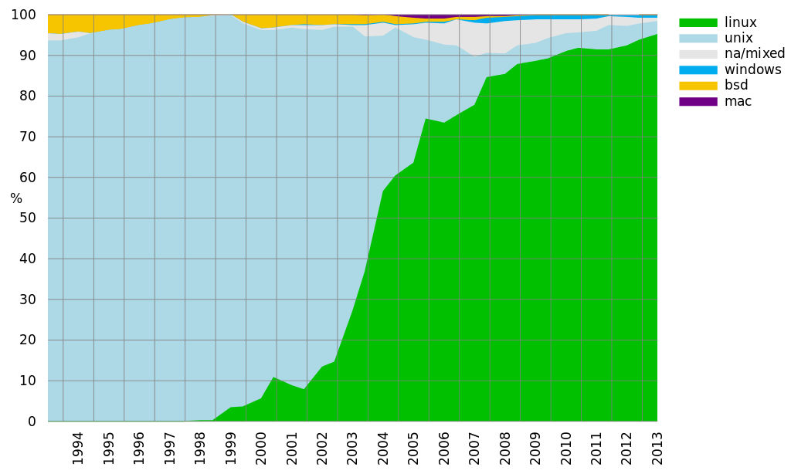
High Performance Supercomputers

Slide 16
Embedded Systems
special-purpose systems in which the computer is completely encapsulated by the device it controls.
They perform pre-defined tasks that have very specific requirements.
Real-time operating systems are embedded systems with certain time requirements.
Includes network routers and switches which frequently use CISCO IOS

